Slide 1



Slide 2
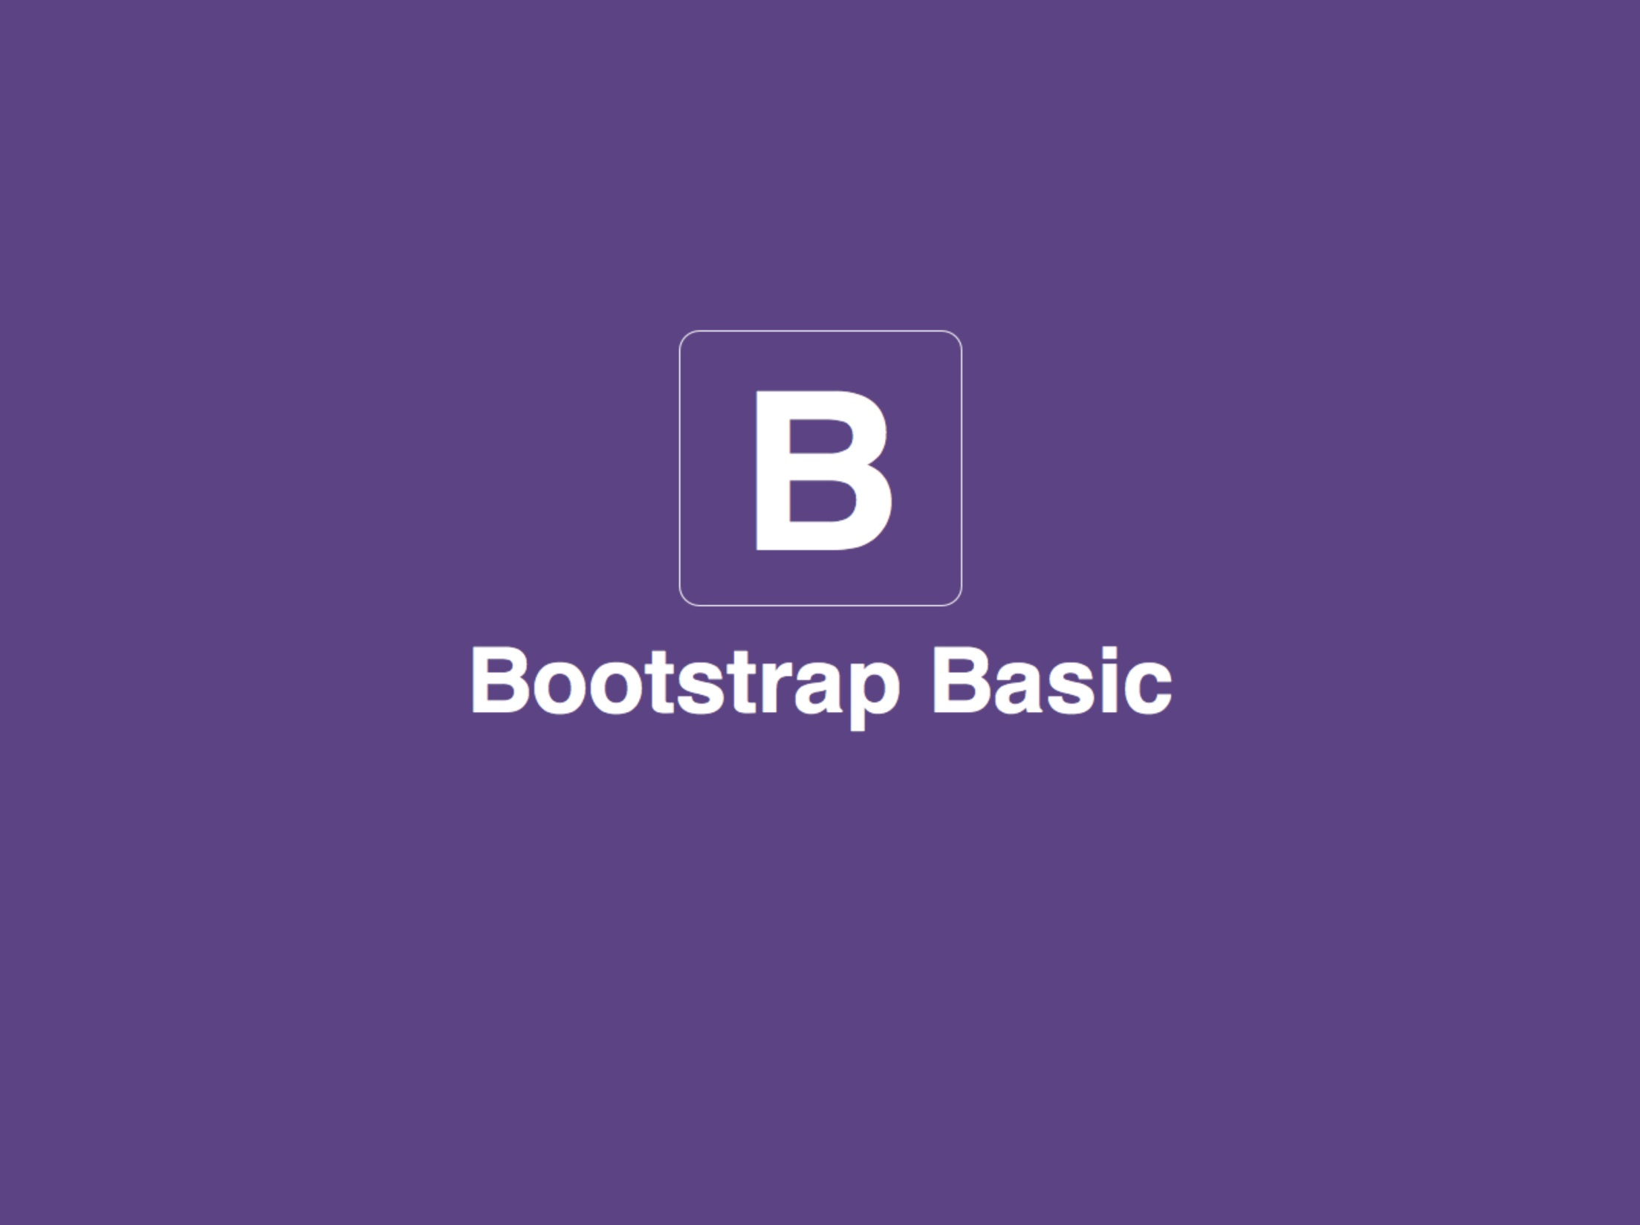

Notes:
<number>

Slide 3



Bootstrap History
Originally created by a designer and a developer at Twitter.
Mark Otto
Designer
Jacob Thornton
Developer
Version 1.0 - 08/19/2011
Version 2.0 - 01/31/2012
Version 2.1.1 - 09/04/2012
Version 2.3.1 - 03/01/2013
Version 3.2.0- 26 /06/ 2014
Version 3.3.1- 12 /11/ 2014
Version 3.3.7- 25 /07/ 2016
on Aug 19, 2015 v4.0.0-alpha

Slide 4

This is the challenge.
How do you design for all of this?
How do you manage the budget (staff, resources)?
Bootstrap is Front-end Framework
HTML, CSS, and JS framework for
developing responsive, mobile first projects on the web.
Notes:
<number>

Slide 5
Why Bootstrap?
● Save 100+ hours of coding:
You can save lots of time and efforts using the Bootstrap predefined design templates and classes and concentrate on other development work.
● Responsive features:
Using Bootstrap you can easily create responsive designs.
● Consistent design:
All Bootstrap components share the same design templates and styles through a central library, so that the designs and layouts of your web pages are consistent throughout your development.
Notes:
<number>

Slide 6
Why Bootstrap?
● Easy to to use:
Bootstrap is very easy to use. Anybody with the basic working knowledge of HTML and CSS can start development with Twitter Bootstrap.
● Compatible with browsers:
Twitter Bootstrap is created with modern browsers in mind and it is compatible with all modern browsers such as Mozilla Firefox, Google Chrome, Safari, Internet Explorer, and Opera.
● Open Source:
And the best part is, it is completely free to download and use.
Notes:
<number>

Slide 7

What is Bootstrap?
Scaffolding: Global styles for the body to reset type and background, link styles, grid system, and two simple layouts.
Base CSS: Styles for common HTML elements like typography, code, tables, forms, buttons & plus includes Glyph icons, icon set.
Components: Basic styles for common interface components like tabs and pills, navbar, alerts, page headers, and more.
JavaScript Plugins: Similar to Components, these JavaScript plugins are interactive components for things like tooltips, popovers, modals, and more.

Slide 8
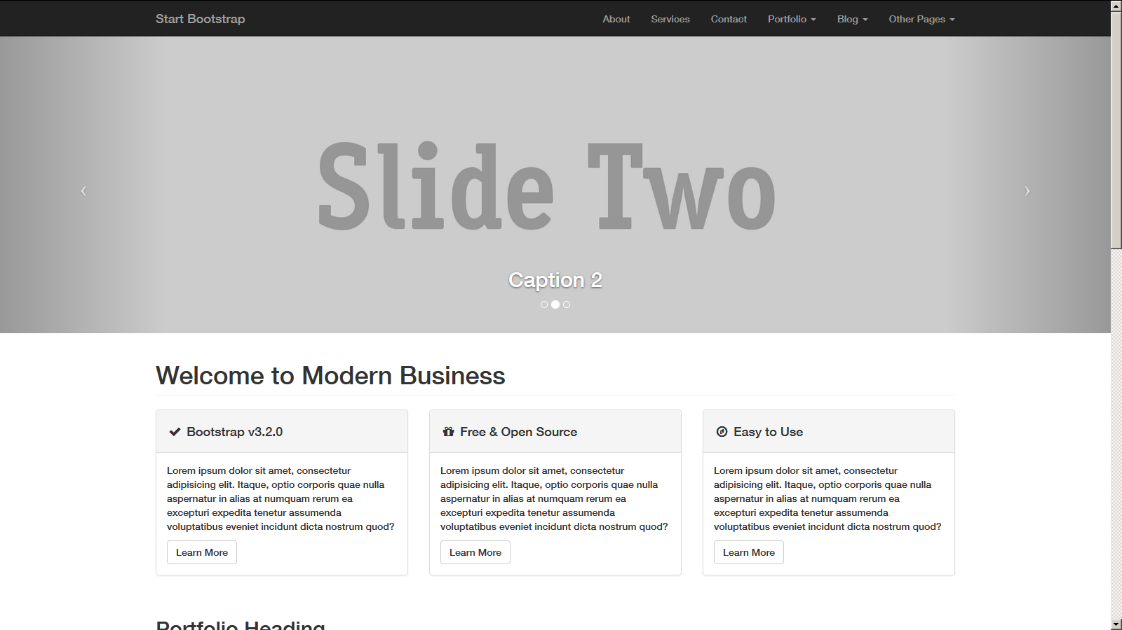
What is Grid in web design?
Notes:
<number>

Slide 9
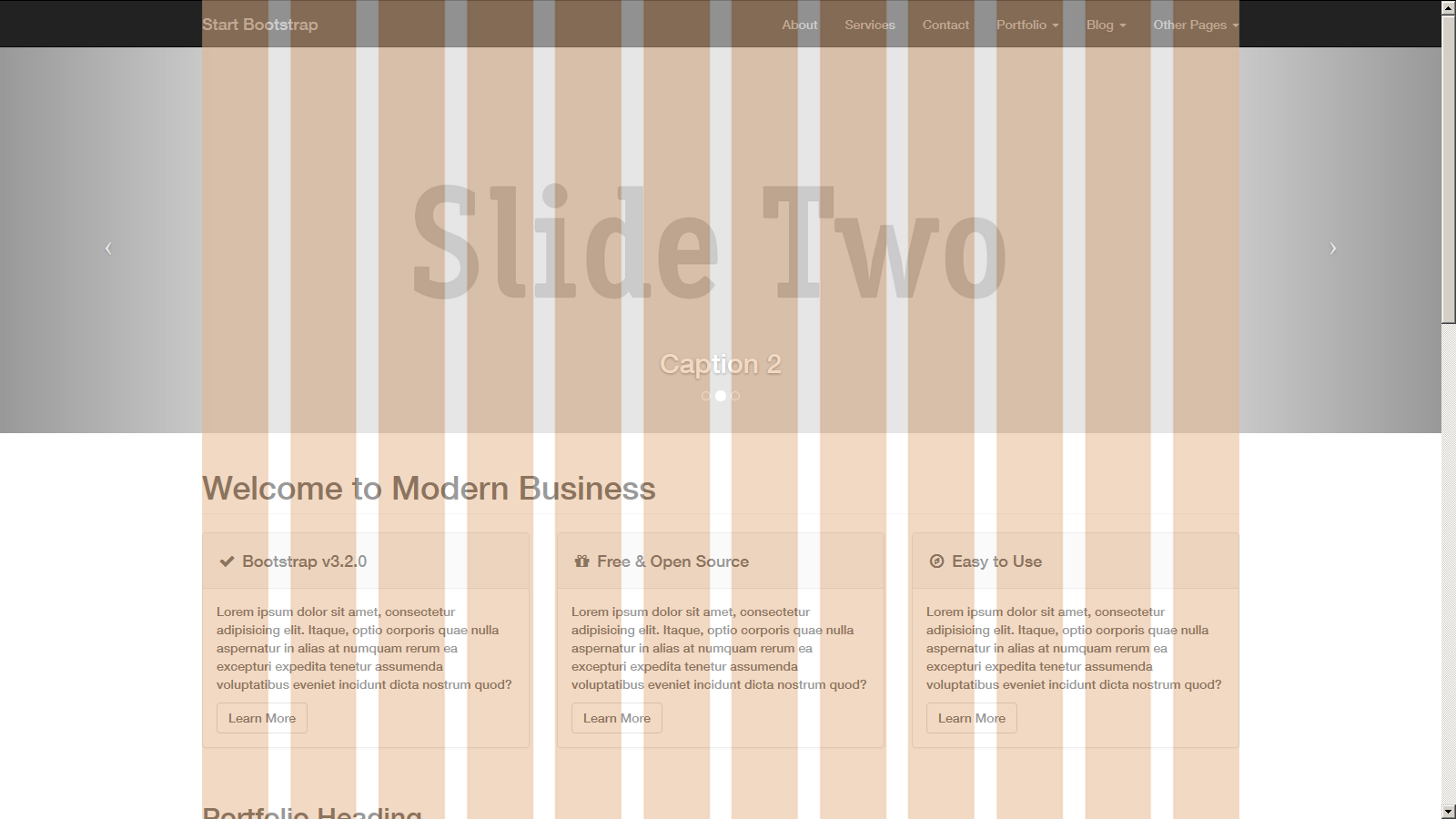
What is Grid in web design?
Notes:
<number>

Slide 10
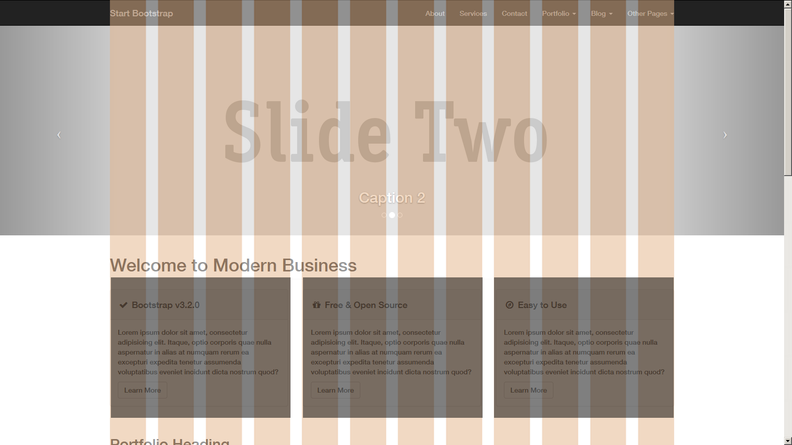
What is Grid in web design?
Notes:
<number>

Slide 11
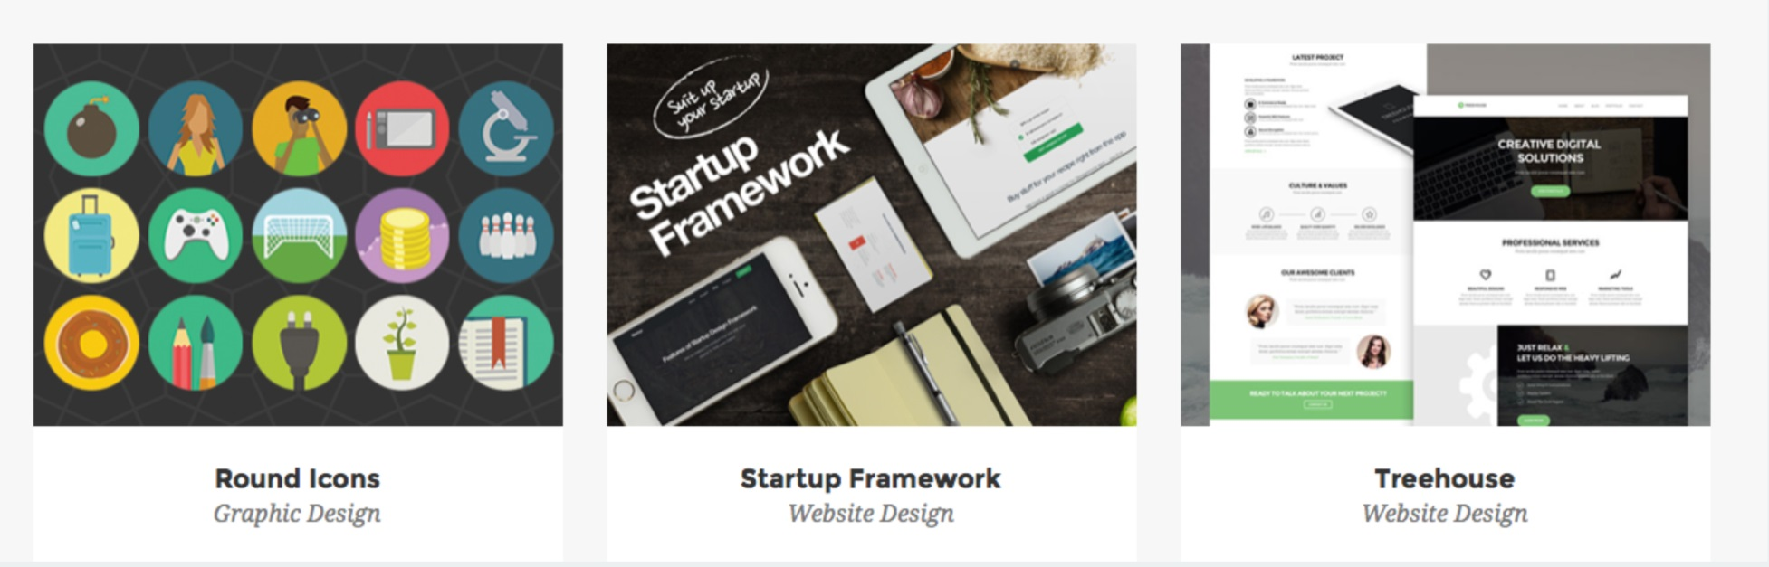
Bootstrap Grid Example
http://bit.ly/bs-agency
How many grids in each box?
Notes:
<number>

Slide 12
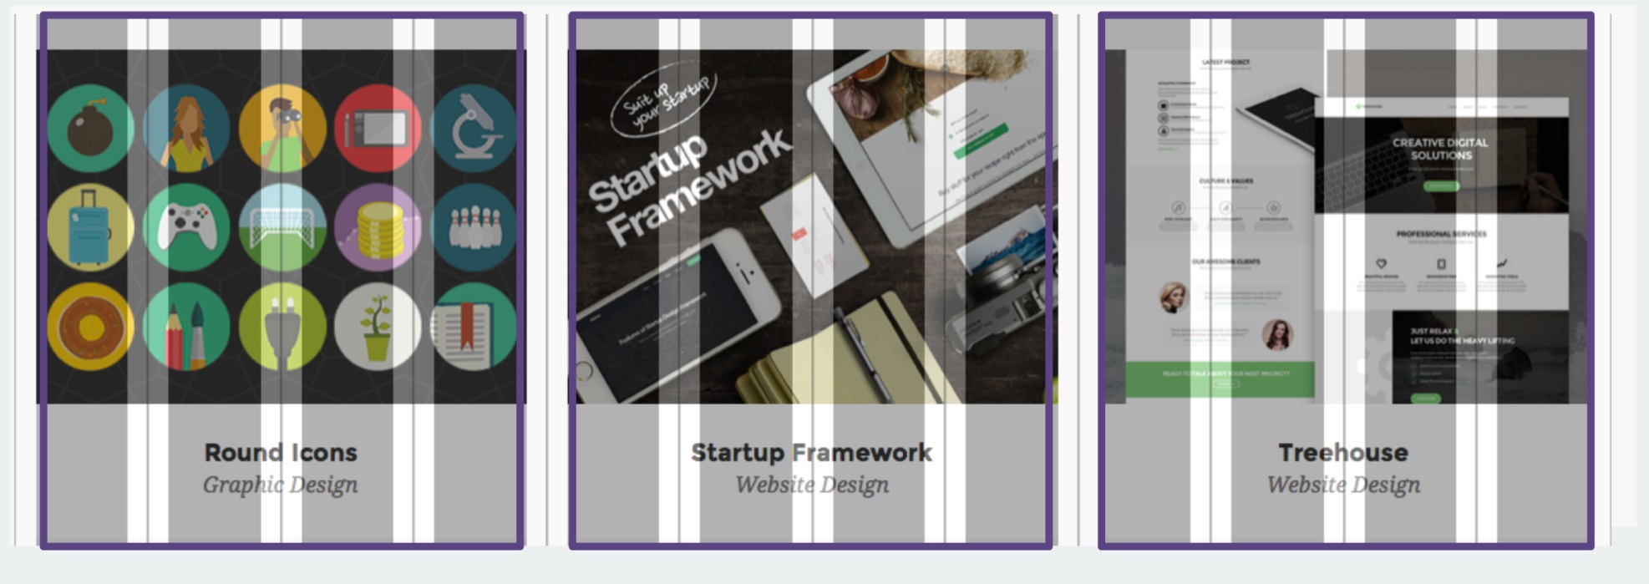
Bootstrap Grid Example
http://bit.ly/bs-agency
4 grids x 3 Columns
Notes:
<number>

Slide 13
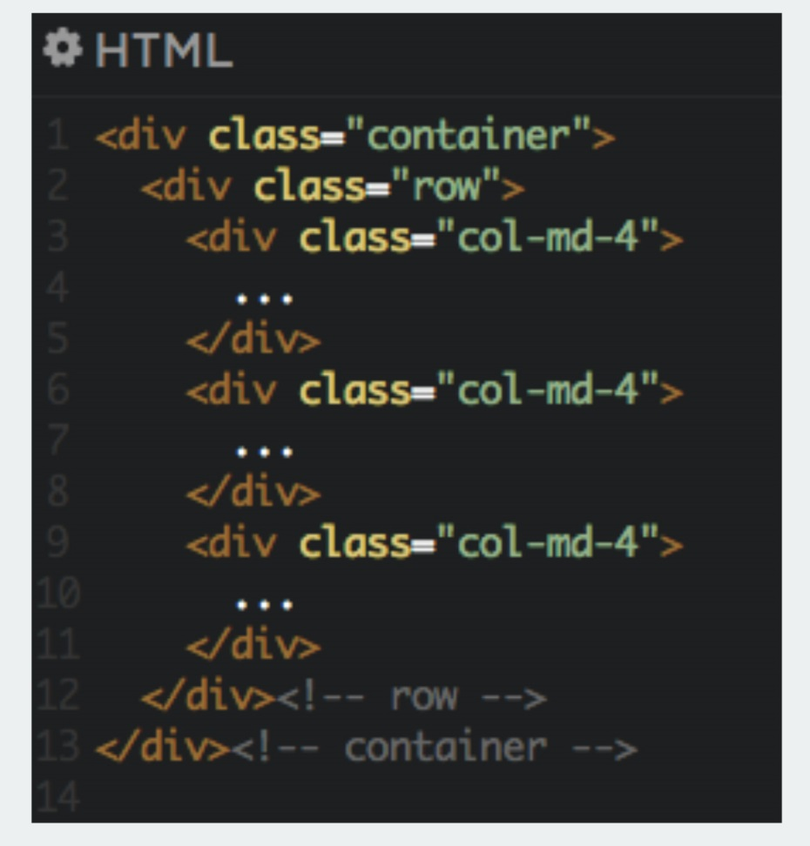
Bootstrap Grid Example
Notes:
<number>

Slide 14
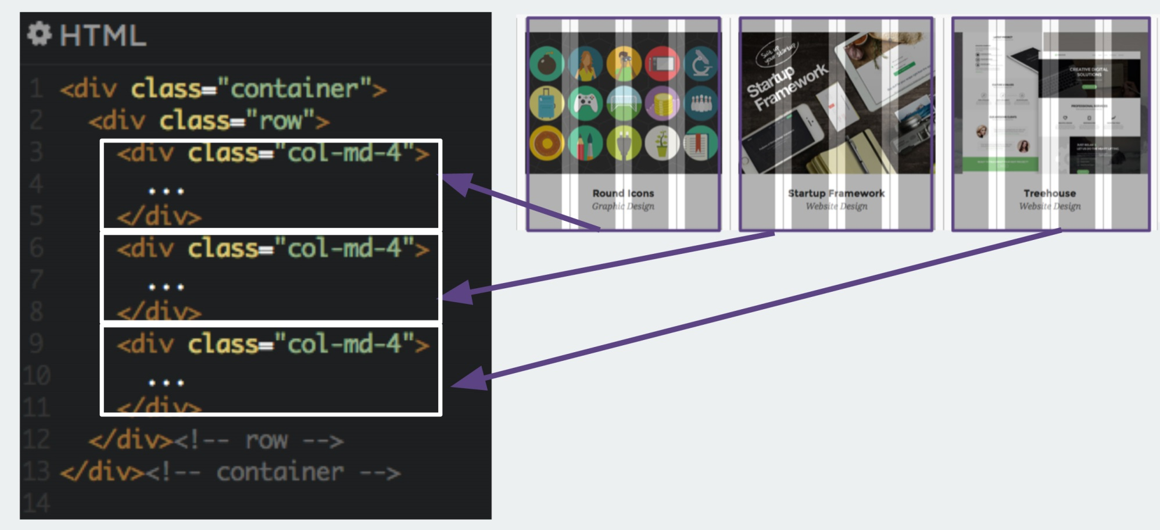
Bootstrap Grid Example
Notes:
<number>

Slide 15
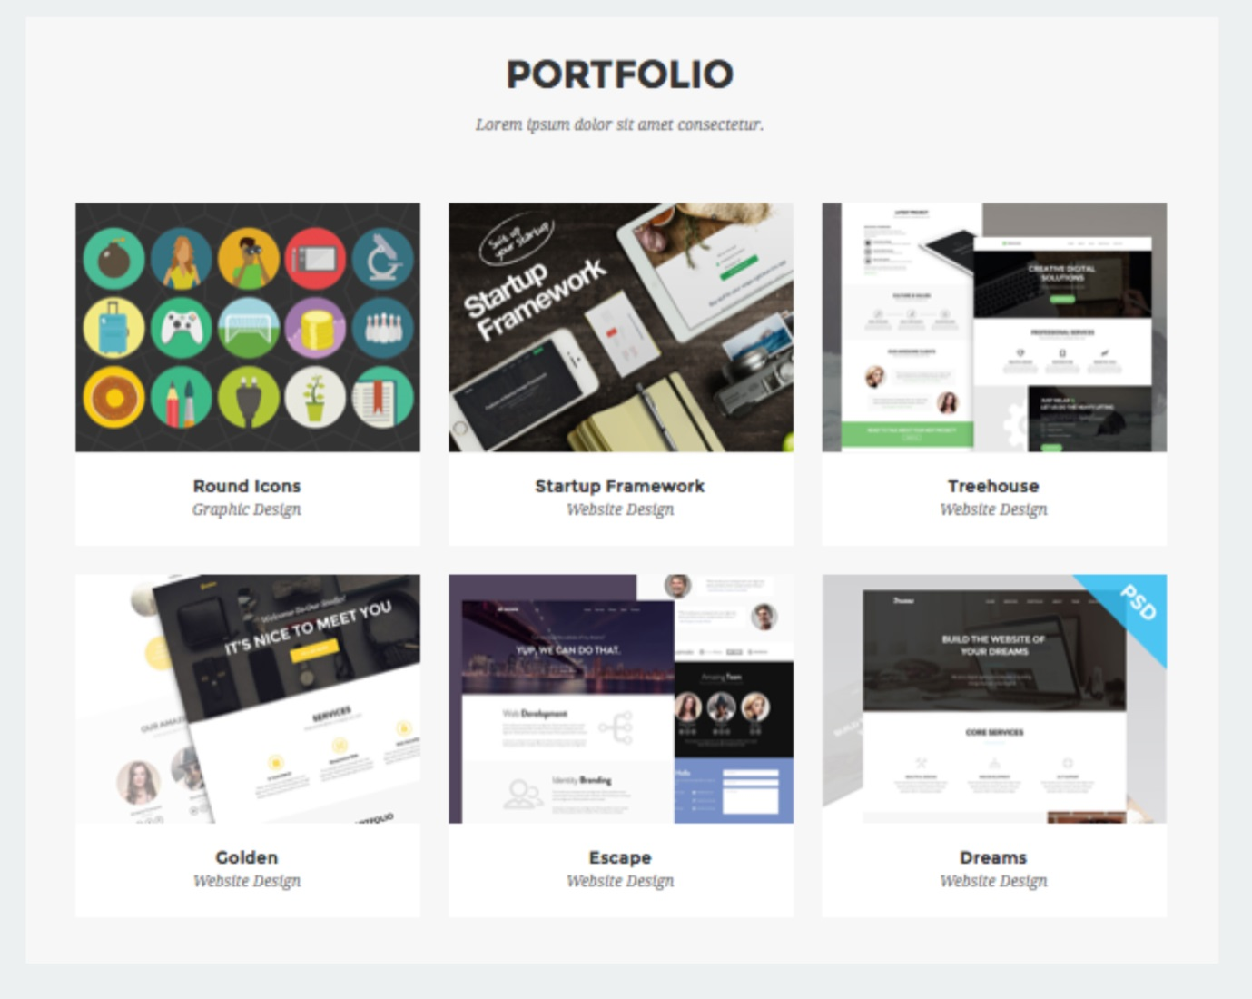
Bootstrap Row
1 Row = 12 Grids
Notes:
<number>

Slide 16
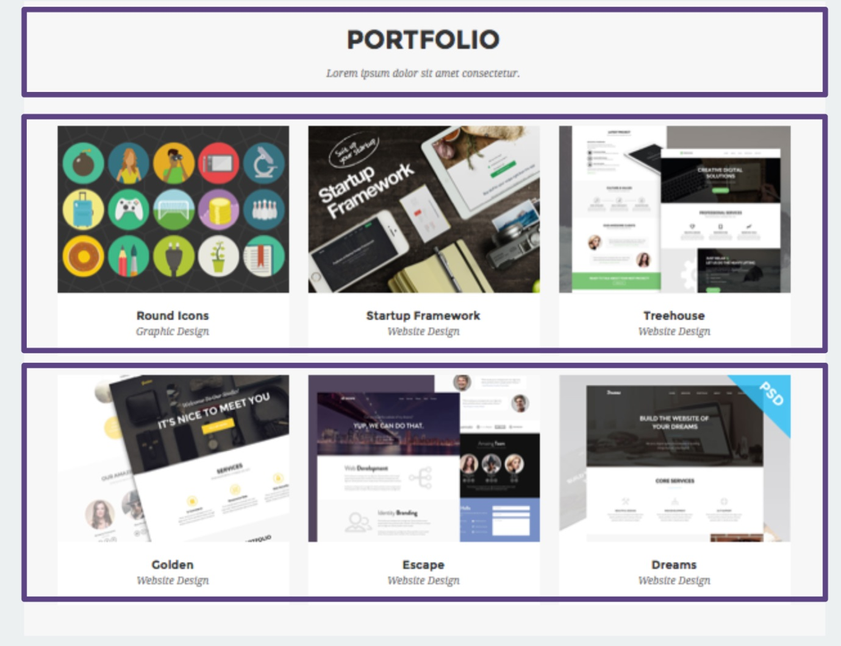
Bootstrap Row
3 Rows
Notes:
<number>

Slide 17
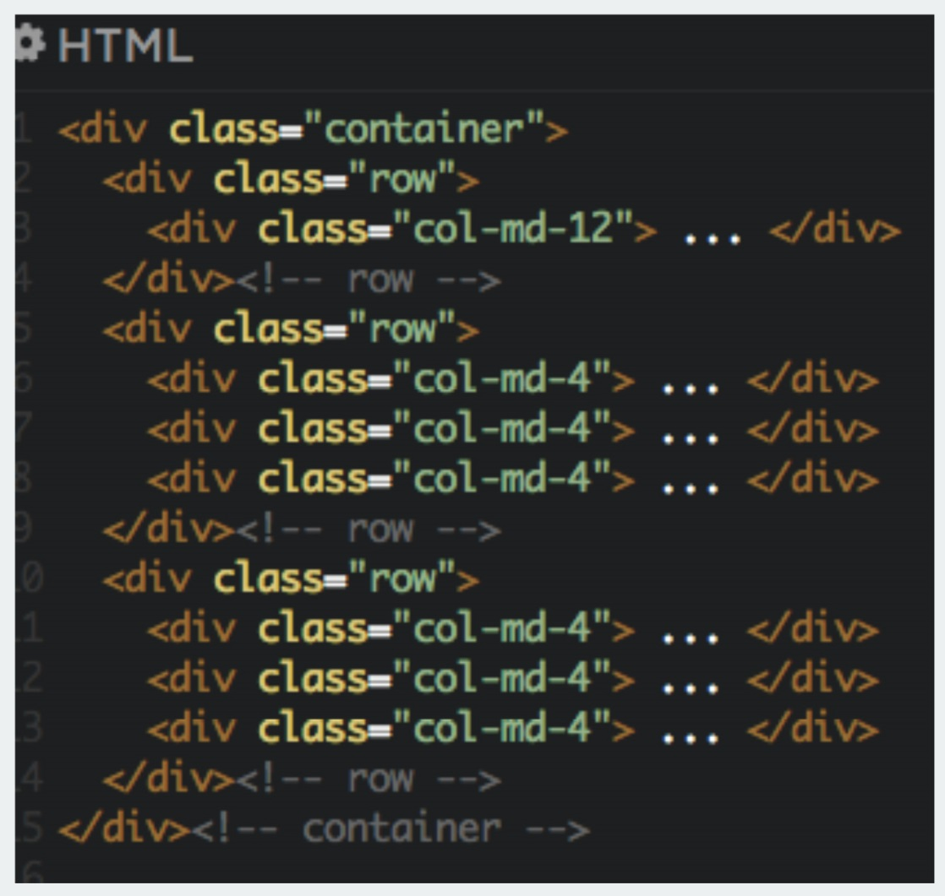
Bootstrap Row
Notes:
<number>

Slide 18
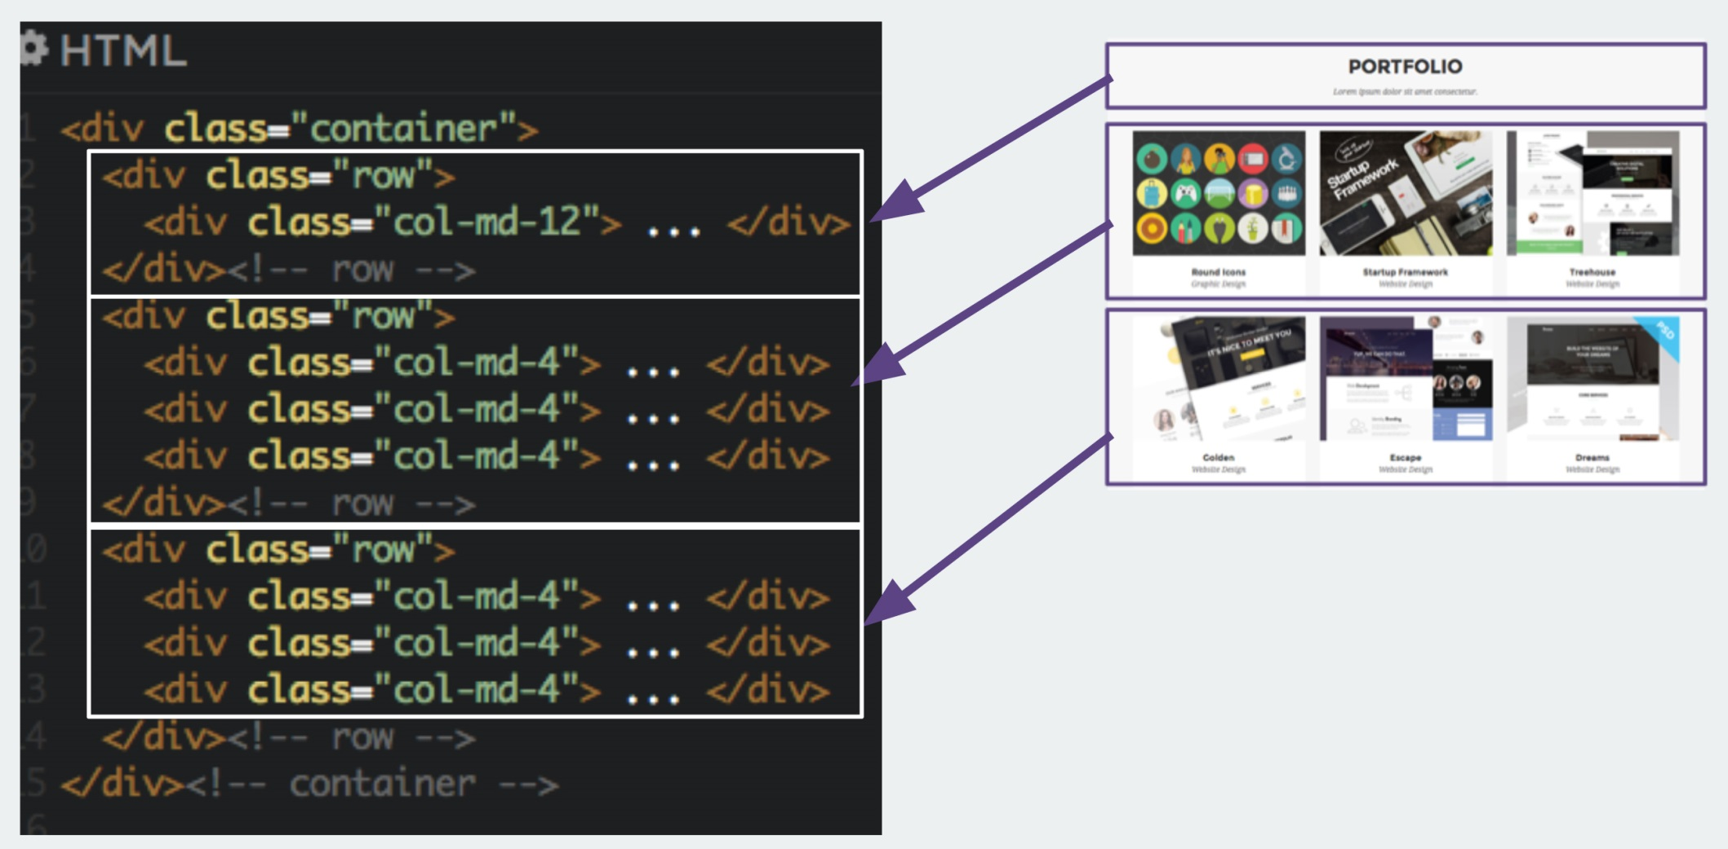
Bootstrap Row
Notes:
<number>

Slide 19
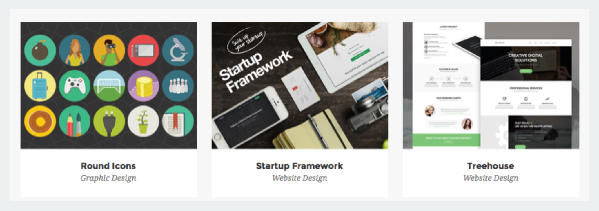
Bootstrap Responsive Grid
Columns will stack when responsive
Notes:
<number>

Slide 20
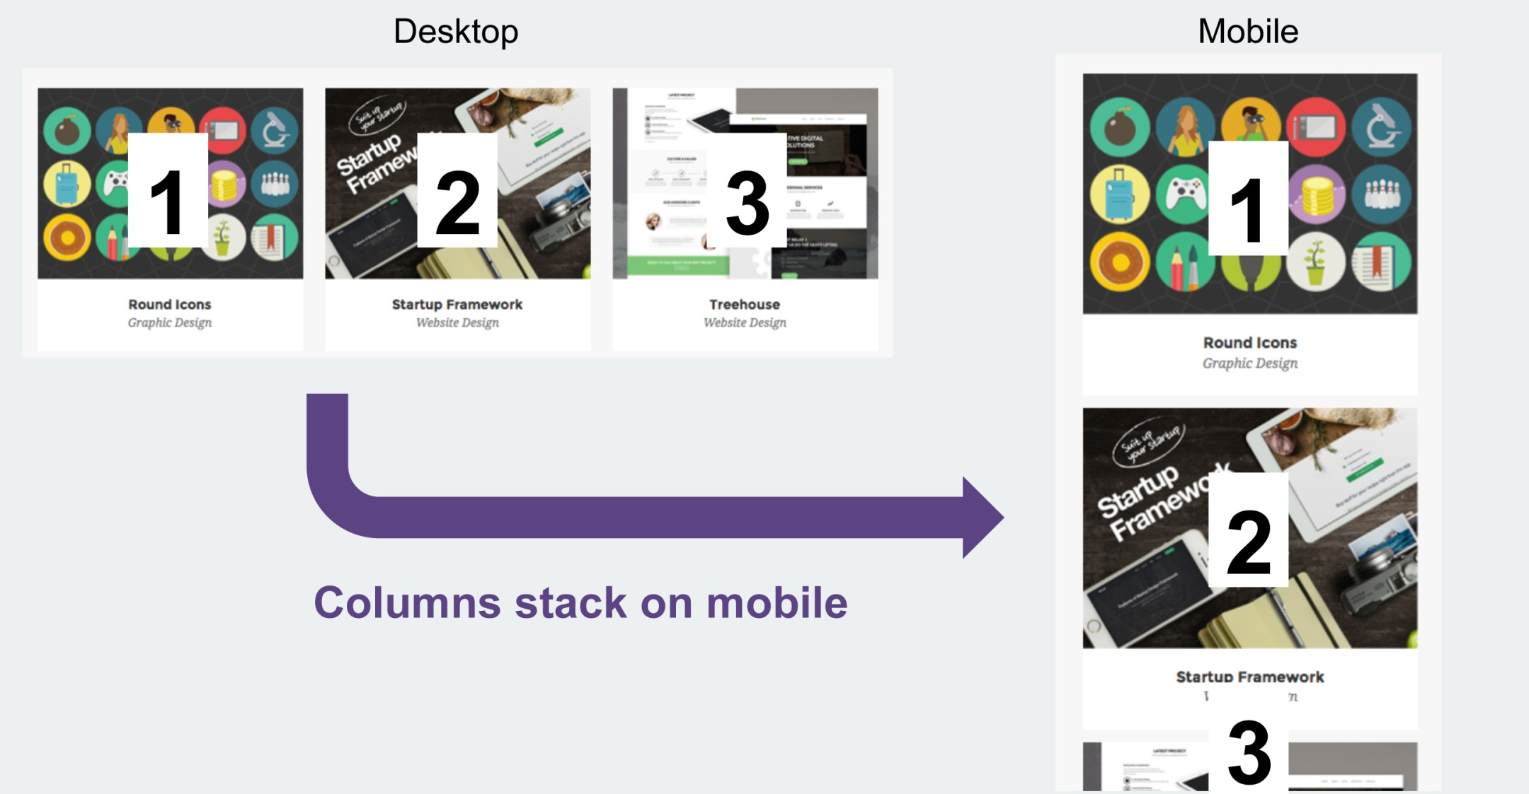
Bootstrap Responsive Grid
Notes:
<number>

Slide 21
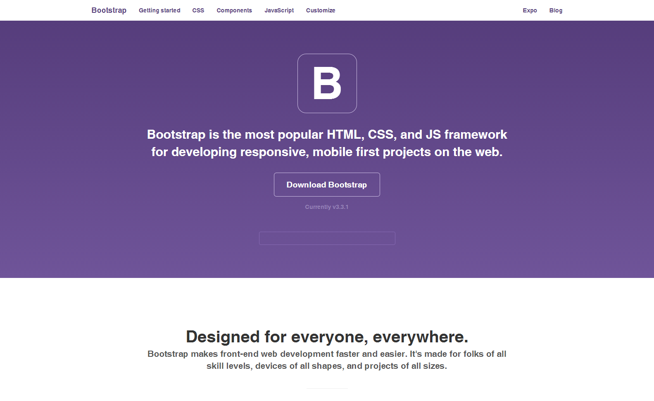
Bootstrap Getting Started
Go to : http://getbootstrap.com/
Notes:
<number>

Slide 22
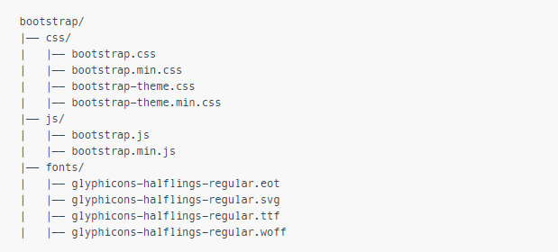
Understanding the File Structure
Notes:
<number>

Slide 23
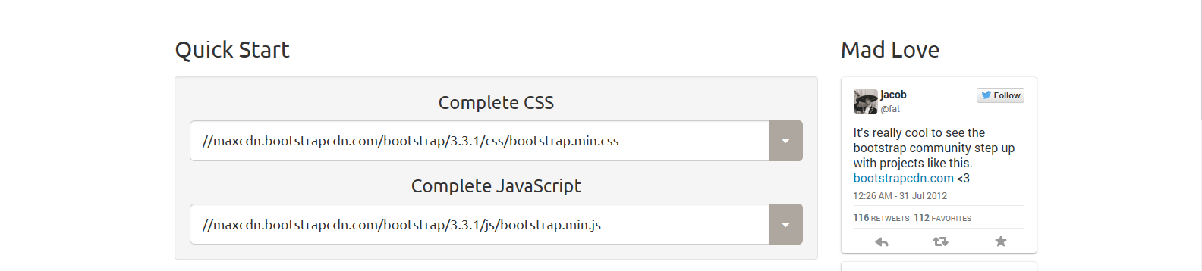
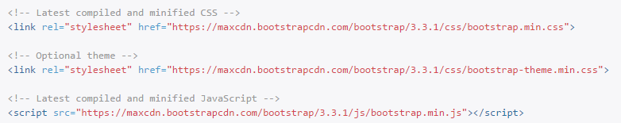
Bootstrap CDN
www.bootstrapcdn.com
http://getbootstrap.com/getting-started/
Notes:
<number>

Slide 24
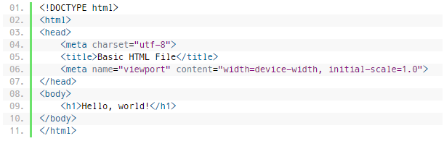
Creating Your Web Page with Twitter Bootstrap
http://www.tutorialrepublic.com/codelab.php?topic=bootstrap&file=basic-html-file
Notes:
<number>

Slide 25
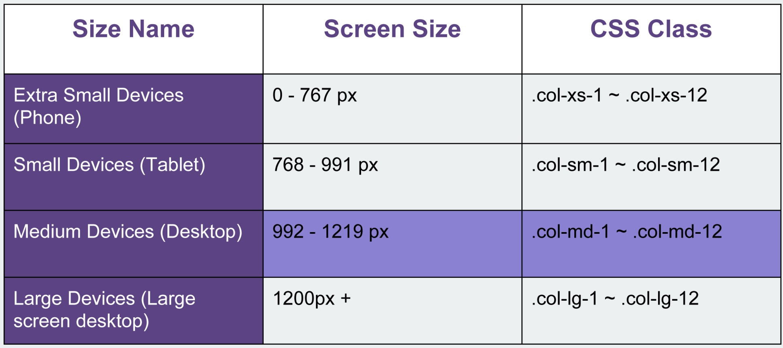
4 Sizes of Bootstrap Grid
Notes:
<number>

Slide 26
Start Create Html With Bootstrap
Notes:
<number>

